Slide 1
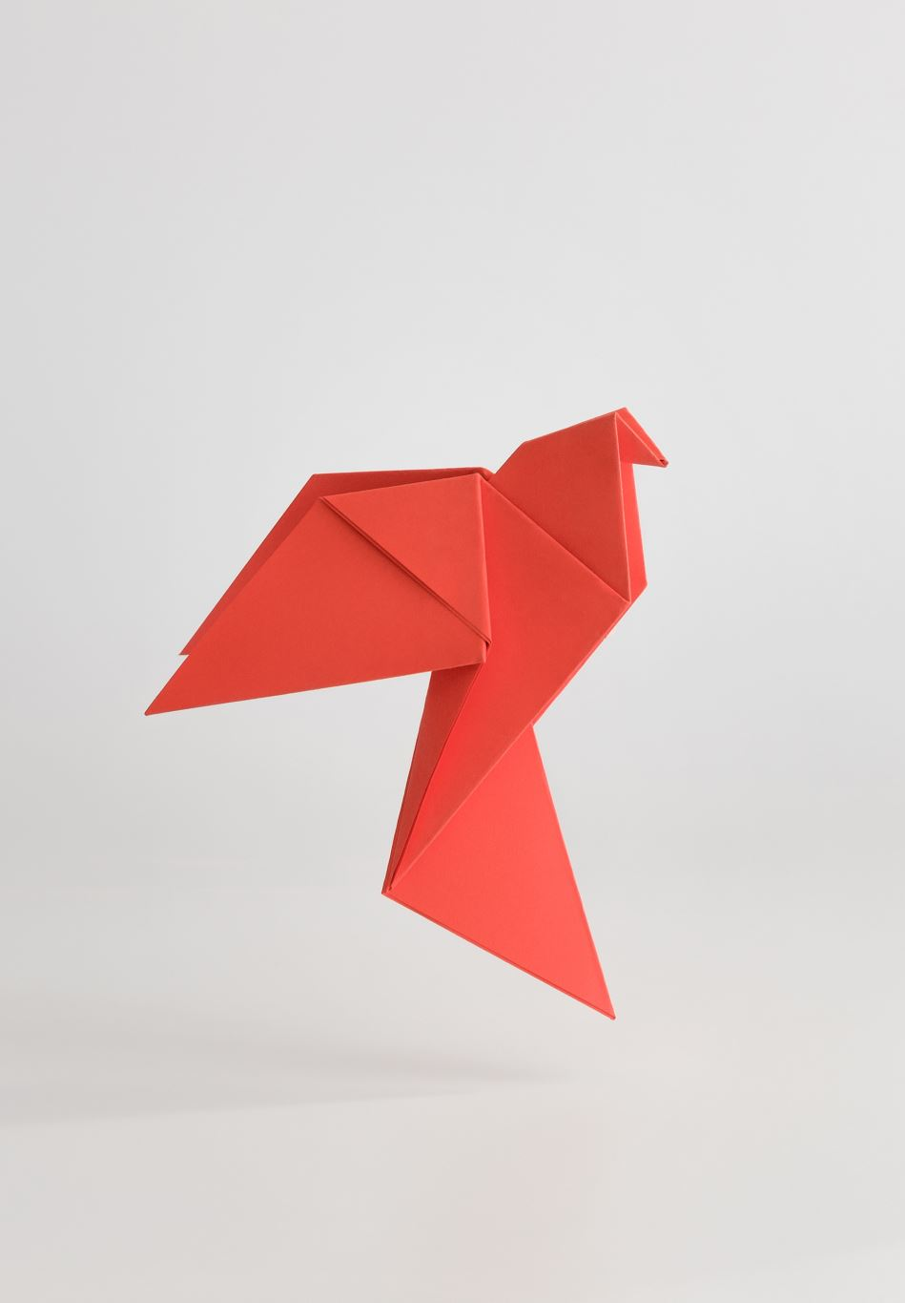


How to undertake a literature search in Scopus
Francesca Gray
Notes:
Hi guys – I have thrown this presentation together a little last minute so you will have to bare with me.
If you have any questions as we go through I am more than happy to be interrupted or you can ask them in the end – I am not a complete Scopus expert so if I do not have the answer and someone else does, feel free to chip in

Slide 2
What is a literature search?
Literature search – considered and organised search to find key
literature on a topic
Notes:
First, a very obvious basic – what is a literature search? It is a considered and organised search to find key literature on a topic. In this presentation, I will briefly explain how we can use Scopus to accomplish this

Slide 3
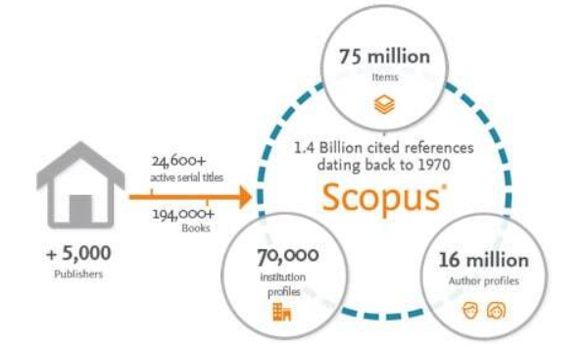
What is Scopus?
Elsevier’s abstract and citation database
Multidisciplinary
Good alternative to Web of Science
(which is better? Depends on what you want and who you ask!)
Notes:
Scopus is an abstract and citation database. You can input your search terms and, when done properly, you can have a finite list of papers that are a great representation of your topic.
Just want to add the caveat that no search will catch every paper ever released on your topic and no database will contain all of them. But Scopus is thought to be up there with the best with over 5,000 publishers and 75 million documents.
It is a good alternative to Web of Science as they are both multidisciplinary and which is better is down to what you want and who you ask. When trying to look into that, there is a vague consensus that Scopus is more inclusive as Web of Science has a more stringent vetting process. But, for a literature search, that is probably a good thing.
(“Scopus is good for a comprehensive study while WoS is better for selective data. That is, for a review article I would prefer Scopus, but for an elaboration on specific scientific problem I would prefer WoS.”

Slide 4

1. Login
Bit obvious but important!
Notes:
So, step one, login!
The University of Aberdeen pay for the subscription so you’ll need to login using your university credentials

Slide 5
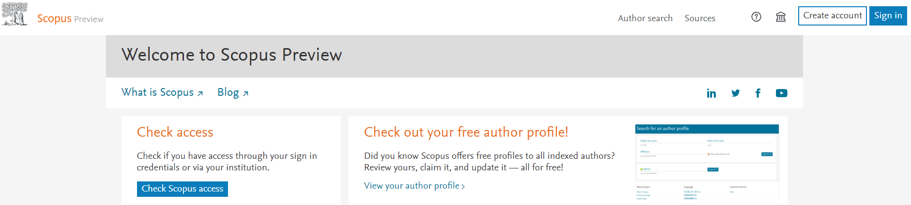
1. Login
https://www.scopus.com/home.uri
Notes:
On their site there are two buttons that let you do this, “Check scopus access” and obviously “sign in”

Slide 6
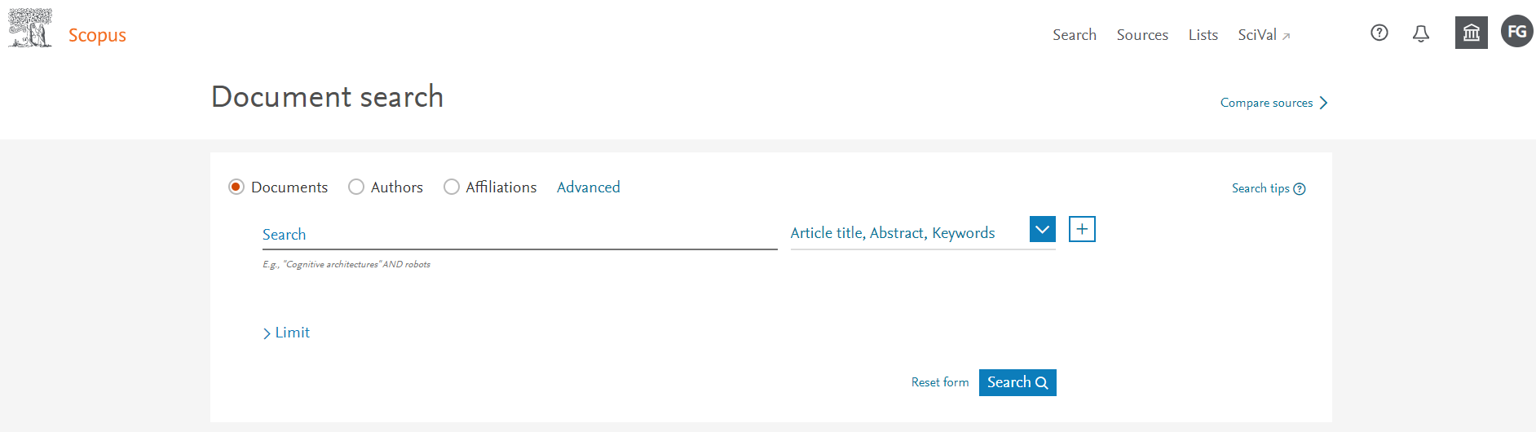
1. Login
Notes:
Once you have logged in, this is what you will see. This is the document search form and this is where you will enter your search terms – we will come back to this later once we know what our search will be

Slide 7


2. Frame your research question
What papers do you want?
Notes:
Before you can do the search, you need to know what you want – frame your research question

Slide 8
2. Frame your research question
Think key words…
Use your project title ☺
Example: The effect of persistent organic pollutants (POPs) on reproduction in wild birds
Notes:
The obvious answer is to use your project title – so lets go through an example…
The example title I am using is from Molly’s project and it is on the effects of persistent organic pollutants on the reproduction of wild birds.
So, lets take the key words…

Slide 9
2. Frame your research question
Pollutants
Bird
Reproduction
Wild
Think key words
Use your title ☺
Example: The effect of persistent organic pollutants (POPs) on reproduction in wild birds
Notes:
So there are 4. you have the pollutants we are interested in, reproduction, wild and birds.
There will be many papers that look at some of this and not at others and I guess this venn diagram should actually be 3D but we are interested in the
overlap of these categories.

Slide 10

3. Way with words
What other words researchers will use when referring to each category?
Notes:
First thing we need to tackle is that there are many different ways to describe the same thing, and when designing a search, it is your job to try and cover this to ensure your search yields a fair representation of the literature

Slide 11
3. Way with words
Pollutants
Bird
Reproduction
Wild
Bird
Reproduction
Avian
Breed
Aves
Fledging success
Passerine
Hatching success
Wild
Persistent organic pollutant
Field
DDT
Free-living
Endrin
Aldrin
Notes:
So I sat and made a list. This list is in no way exhaustive – I select a handful for the purposes of this presentation. If I was doing this for real, this lists would be a lot longer.
But as you can see, I have got a bit of colour coding going on.
Bird could be avian, aves which is the class, and passerine
Wild could be field study or free-living birds
Reproduction could be breeding or fledging or hatching success
For the pollutants, I just listed a couple…

Slide 12

3. Way with words
How does Scopus read your search?
Bird
Reproduction
Avian
Breed
Aves
Fledging success
Passerine
Hatching success
Wild
Persistent organic pollutant
Field
DDT
Free-living
Endrin
Aldrin
Notes:
And from here we are going to spend a little bit of time on how Scopus reads what we enter into the search box and how we can use this to our best advantage

Slide 13
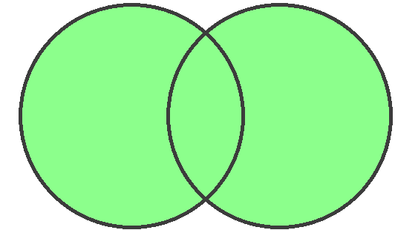
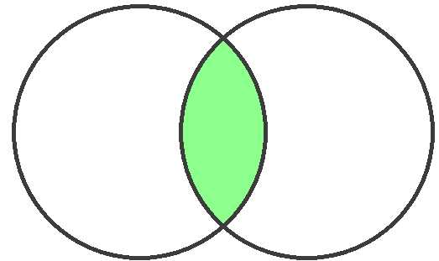
3. Way with words
A B
A B
OR
AND
Boolean operators
Bird
OR
Avian
OR
Aves
OR
Passerine
OR = any one of the following
AND
AND = all of the following
Wild
OR
Field
OR
Free-living
AND
Reproduction
OR
Breed
OR
Hatching success
OR
Fledging success
AND
Persistent organic pollutant
OR
DDT
OR
Endrin
OR
Aldrin
Notes:
First we are going to deal with linking our words together – and we do this using different operating words such as OR. We put OR in between words of the same category and it will flag papers that uses one or more of these words
AND is used between different categories as we only want papers that incorporate all of our categories

Slide 14
3. Way with words
Bird
OR
Avian
OR
Aves
OR
Passerine
AND
Wild
OR
Field
OR
Free-living
AND
Reproduction
OR
Breed
OR
Hatching success
OR
Fledging success
AND
Persistent organic pollutant
OR
DDT
OR
Endrin
OR
Aldrin
Notes:
So, lets go through the rules – what does Scopus see?

Slide 15
3. Way with words
Notes
Capitalisations are ignored
Bird
OR
Avian
OR
Aves
OR
Passerine
AND
Wild
OR
Field
OR
Free-living
AND
Reproduction
OR
Breed
OR
Hatching success
OR
Fledging success
AND
Persistent organic pollutant
OR
DDT
OR
Endrin
OR
Aldrin
Notes:
First, it ignores capitalisation so lets remove that

Slide 16
3. Way with words
Notes
Capitalisations are ignored
Punctuation is ignored
bird
OR
avian
OR
aves
OR
passerine
AND
wild
OR
field
OR
free-living
AND
reproduction
OR
breed
OR
hatching success
OR
fledging success
AND
persistent organic pollutant
OR
ddt
OR
endrin
OR
aldrin
Notes:
Second, it ignores punctuation.
For example, free living is seen as two separate words as it ignores the dash so lets change that

Slide 17
3. Way with words
Notes
Capitalisations are ignored
Punctuation is ignored
Loose phrases - phrases need to be “grouped”
bird
OR
avian
OR
aves
OR
passerine
AND
OR
“free living”
Would search for papers as ‘free’ AND ‘living’
wild
OR
field
free living
AND
reproduction
OR
breed
OR
hatching success
OR
fledging success
AND
persistent organic pollutant
OR
ddt
OR
endrin
OR
aldrin
Notes:
Next is something called loose phrases
basically if one of your search terms is two words, encapsulate them in double quotation marks so Scopus assesses them together.
For example, free living, with or without the dash, would be read by Scopus as looking for papers with both the word free and the word living. By using the quotation marks, it binds them together in a phrase. So lets add the necessary double quotation marks

Slide 18
3. Way with words
Notes
Capitalisations are ignored
Punctuation is ignored
Loose phrases - phrases need to be “grouped”
Wildcards
bird
OR
avian
OR
aves
OR
passerine
AND
wild
OR
field
OR
“free living”
AND
reproduction
OR
breed
OR
“hatching success”
OR
“fledging success”
AND
“persistent organic pollutant”
OR
ddt
OR
endrin
OR
aldrin
Notes:
The next is wildcards. In this example, the wildcard I need is an asterisk

Slide 19
3. Way with words
Notes
Capitalisations are ignored
Punctuation is ignored
Loose phrases - phrases need to be “grouped”
Wildcards
bird
OR
avian
OR
aves
OR
passerine
We also want ‘reproduce and reproduces:
reproduc*
AND
wild
OR
field
OR
“free living”
AND
reproduction
OR
breed
OR
“hatching success”
OR
“fledging success”
AND
“persistent organic pollutant”
OR
ddt
OR
endrin
OR
aldrin
Notes:
Take reproduction. There are other versions of the word such as reproduce, reproductive and reproduces. By cutting off the T I O N and adding the asterisk, all of these different forms are included.
Lets add any others we need

Slide 20
3. Way with words
Another wildcard is ?:
(woman OR women) → wom?n
Notes
Capitalisations are ignored
Punctuation is ignored
Loose phrases - phrases need to be “grouped”
Wildcards
*bird
OR
avian
OR
aves
OR
passeri*
We also want ‘reproduce and reproduces:
reproduc*
AND
wild*
OR
field
OR
“free living”
AND
reproduction
OR
breed*
OR
“hatching success”
OR
“fledging success”
AND
“persistent organic pollutant”
OR
ddt
OR
endrin
OR
aldrin
Notes:
Bird has an asterisk at the start to incorporate the word seabird and wild has one at the end to incorporate the word wildlife
Another wild card is the question mark. For example, in a search, if you wanted woman and women you would add a ? In the place of the e and the a. The question mark represents any single character whereas the asterisk represents any number of characters, even none.

Slide 21
3. Way with words
Notes
Capitalisations are ignored
Punctuation is ignored
Loose phrases - phrases need to be “grouped”
Wildcards
Plurals are ignored
Exact word/phrase – { }
*bird
OR
avian
OR
aves
OR
passeri*
Seen as ‘ave’ which gave papers with ‘avenue’ and ‘avenues’
{aves}
AND
wild*
OR
field
OR
“free living”
AND
reproduc*
OR
breed*
OR
“hatching success”
OR
“fledging success”
AND
“persistent organic pollutant”
OR
ddt
OR
endrin
OR
aldrin
Notes:
The next is that plurals are ignored. When running this search you would run into a problem with aves
As the s is ignored, you would incorporate any paper where the words avenue or avenues is used instead of the needed bird word.
This is where the curly bracket come in as exact phrases – this stops Scopus from implementing any of its rules to this search term.

Slide 22
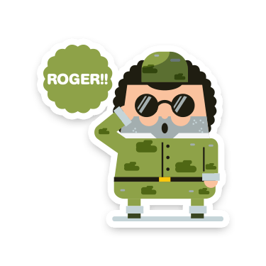
3. Way with words
Boolean operators order of precedence:
OR
AND
AND NOT (NB. should always be used at the end of the query)
Example
"KEY(mouse AND NOT cat OR dog)" →"KEY((mouse) AND NOT (cat OR dog))"
Notes:
There is another operator – and not.
This helps you exclude search terms. As a note for this, as the order of precedence is OR, then AND and then AND NOT, it should always be placed at the end.
In this example, you can see the placement of brackets to demonstrate how Scopus reads this

Slide 23
3. Way with words
Pollutants
Bird
Reproduction
Wild
(
OR
)
*bird
OR
avian
OR
aves
passeri*
AND
(
wild*
OR
field
OR
“free living”
)
AND
(
OR
“hatching success”
OR
)
reproduc*
breed*
OR
“fledging success”
AND
(
OR
)
“persistent organic pollutant”
OR
ddt
OR
endrin
aldrin
Notes:
With this, each category is read first with the OR operator and then the ANDs are read

Slide 24
3. Way with words
“hatching success” → “hatching W/2 success”
to include ‘success at hatching’
Proximity operators:
W/n: Indicates distance between words, but not the order
Pre/n: Terms must appear in a specific order between words
Examples
‘zika Pre/2 virus’: find ‘zika virus’ but also ‘zika and dengue virus’
‘zika W/2 virus’ would look for ‘virus infection with zika,’ ‘Virus like zika,’ ‘virus, zika,’ ‘zika virus,’ etc.
Notes:
Next we have proximity operators.
W/n indicates a distance between words. By changing the N to a number, you can set the number of words that can separate them.
Pre/n is the same but it forces the order of these words.
When looking at our search, if we changed hatching success to hatching W/2 success, it would also include papers with the phrase success at hatching.

Slide 25
4. Inputting your search
Notes:
Next we are on to inputting the search into Scopus.

Slide 26
Change what you are searching within – for a literature search, stick with this
Search goes in here
If your search is too long, click this and more space will be added
Notes:
So, we are back to the document search.
Your search goes here
You can change what Scopus searches within, the default is Scopus searching for terms within a paper’s article title, its abstracts and its keywords
And the plus symbol allows you to input more search terms if you have too many for the box

Slide 27
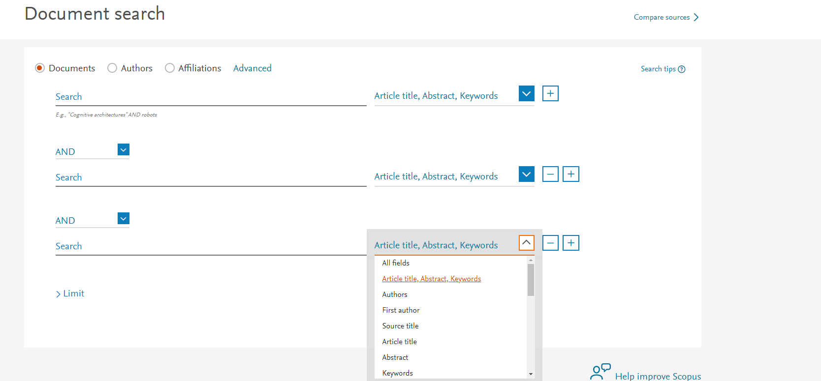
If you want to mix and match what you search within, this is how you do it
Notes:
If you click the plus you get something like this
This is also helpful if you want to mix and match what you search within as you can see by the drop down here

Slide 28
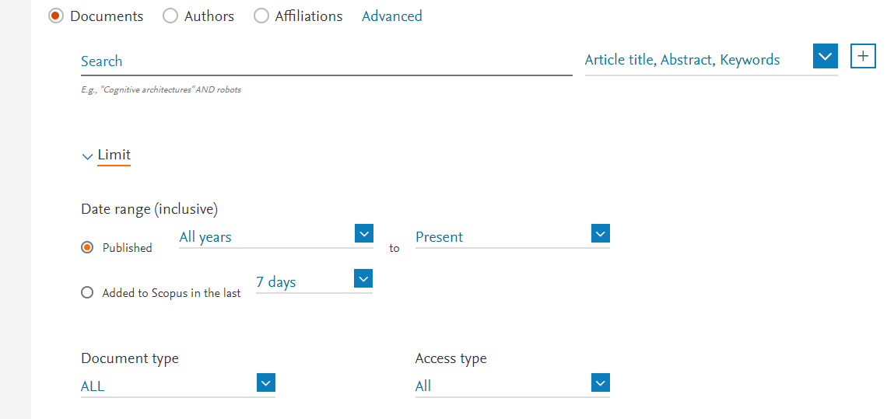
Can limit:
Publication year
Time since added to Scopus
Document type (helpful to limit to journals or reviews)
Notes:
Below the search box is a drop down called limit which allows you to limit by publication year, time since added to Scopus which is helpful if you are coming back to a topic, and document type which is helpful to limit to journals or reviews if you want

Slide 29
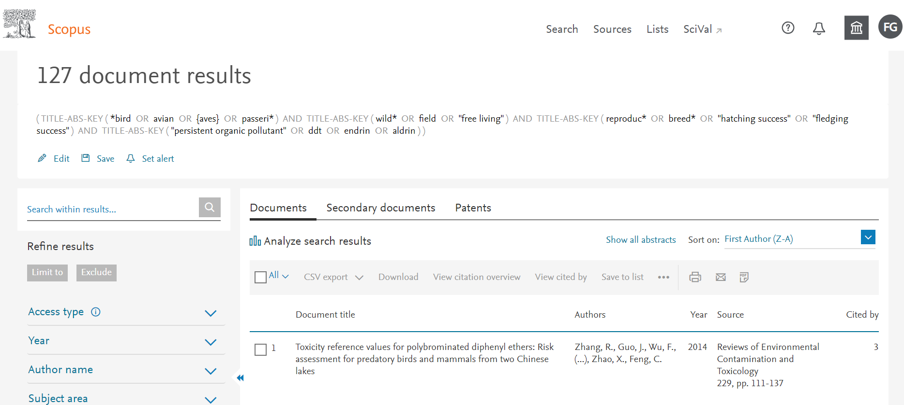
Number of results
Edit your search if you are not happy
Save your search for later (will add any new papers)
Refine by all sorts – my favourites are key words, journals and subject type
Set alert for new papers added to Scopus
Notes:
Using my previous example, if we implemented the search, we yield 127 documents.
If you notice a mistake you can edit your search with the edit button
If you want to save your search you can with the save button. When you run it at a later date the number of papers may have increased as new papers get added to Scopus.
With the set alert button you can organise Scopus to contact you as new papers get added to Scopus that fit your search. I have a weekly alert set for mine
If you want to reduce the number of papers in your search you can refine it with the many options on the left (there are more than that, I just had to crop them out). There is also nothing stopping you from refining your search and saving the refined list (see next slide)

Slide 30
Do not want new papers added when you come back? Save to list (need to select all first)
Save your search for later (will add any new papers)
Notes:
With saving you search for later, every time you run it you may have gained more papers. When doing something like a meta analysis, you may need to just cut off this influx and deal with what you have. To do this you can save your papers to a list instead using the “Save to list” button (you need to select them first by either clicking papers individually or clicking the All button as indicated). There is nothing stopping you from saving the list to focus on those papers and have a cheeky look at the papers that come through to your email if you set up an alert.

Slide 31
Do not want new papers added when you come back? Save to list (need to select all first)
Access saved lists and searches here
NB: Can only do this for 2000 papers at a time… that is okay though as you can combine lists if need be
Notes:
As a note, you can only save 2000 papers at a time (seems to be the amount of papers Scopus can deal with at a time). If you have more than that, save the 2000 into a list. Load the excess papers you were not able to save, click ‘save to list’ and you can add them to the first lot from there – very sneaky

Slide 32
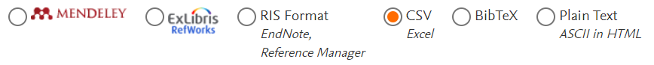
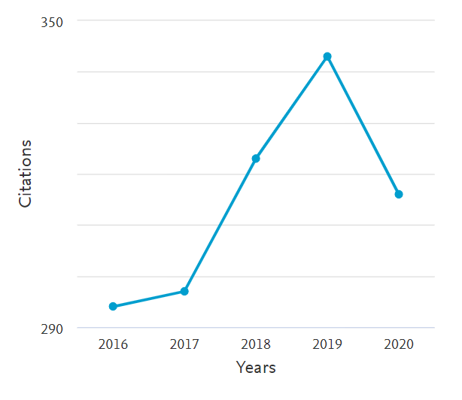
Reverse snowballing
‘View references” = Snowballing
Notes:
You can also export a search result (whether from an ongoing search or a saved list), using the export button. When you select this you can also refine exactly what you want (can even export to abstract if you wish!)
Citation overview is fun. If you want to see the progress within your topic (i.e. how popular it is), you can see this here (remember on this example 2020 hasn’t finished yet!)
View cited by is a way to see a list of papers that cited the papers that are in your search. This is very helpful when wanting to make sure your key words didn’t miss anything. Your search terms are a fine balance of reducing the number of papers you have to sift through and trying to incorporate as many of the relevant papers as possible (the refine results options will most likely come in handy with reverse snowballing)
You can see which papers the papers in your results cited by the view references button in the drop down (…). Full disclosure this is not the best as most papers are not open access and thus Scopus cannot access their reference lists – but the option is there if you wish.

Slide 33
Allows you to accept or reject a paper within Scopus
Sort list: typically either by author or year but there are others
Notes:
If you want all the abstracts on the main screen (rather than clicking each paper individually), you can use the ‘show all abstracts’ button – there are a couple of abstracts missing, typically in older papers that have only scanned copies online. The majority are their though and is very helpful
You can also sort the papers in different ways. You will most likely want it by year or the First Author (A-Z) default (do not know why the screen shot in Z-A, must have caught it)

Slide 34


Done!
Questions?
Notes:
Viola – hope that helped. Scopus have some great tutorial videos too if you are looking for more information ☺

